Slide 1
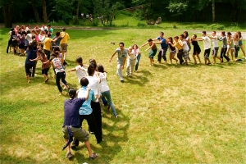
Traditional games of Russia and England
Выполнила ученица 5 б класса
МБОУ СОШ№33
Кузнецова Инга

Slide 2
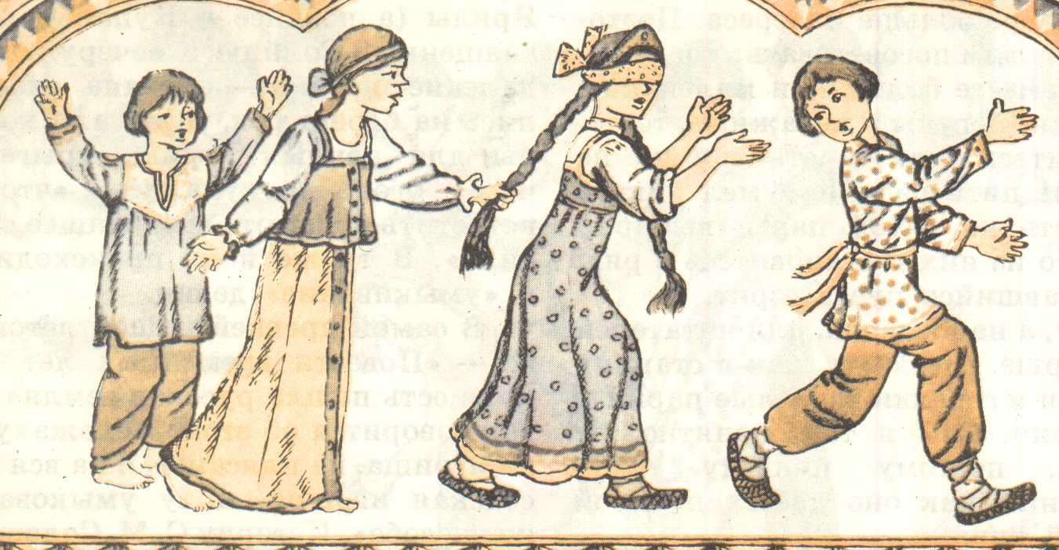
Traditional games
In the culture of each nation here are many games. For centuries, these games are accompanied by daily life of children and adults, they improve next qualities: endurance, strength, quickness,honesty, fairness and dignity.
Russian folk games have a history of millennia: they have survived since the days of ancient times, passed on from generation to generation, incorporating the best national traditions.
National traditions of the game have a great influence on the education of character, strength of will, interest in folklore among young people and promotes physical culture.
Playing in the national outdoor games, baby absorbs a piece of the soul of the people, which allows it to grow not only man, but also a citizen. After the game, by the people for a long time, the child learns and learns to communicate with their peers, which is important.

Slide 3
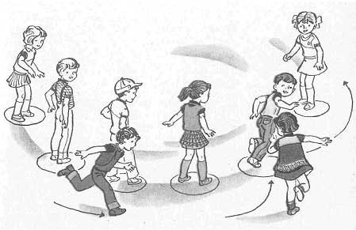
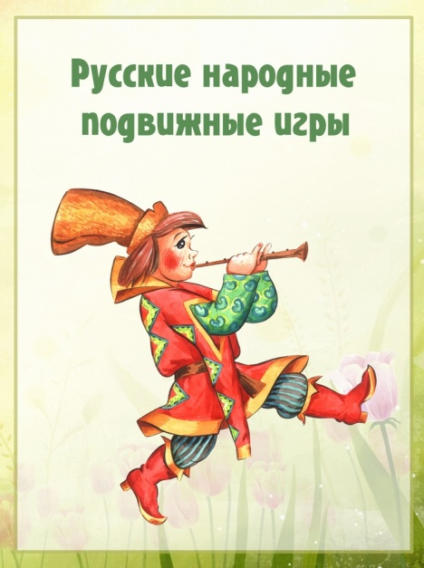
Russian traditional games
The Russian people reflect many of the processes of their ability to live through the game. Folk games are relevant and interesting, and at present, they can be used in the work with the pupils and preschool children, recreation camp, and in his spare time with his family. On Shrove Tuesday, Christmas, Easter, the great Christian festivals, people spend their time funny and interesting.

Slide 4
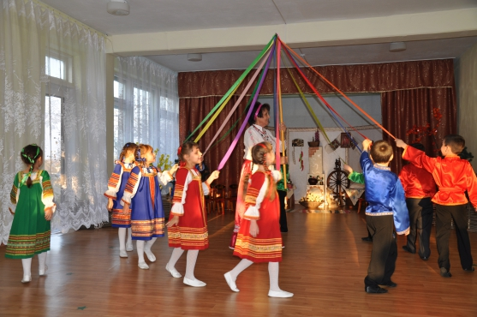
The games for children
Russian folk games for children have always been popular among the small, winding fidgets. We have played games since ancient times and now play with mothers, and grandmothers, and friends during celebrations, fun activities, national holidays.
"Carousel"
By the hoop the tape is attached. Children take up the tape with one hand and come first in one direction and then reversing arm to another. Adult keeps wrape, everybody sings a song:
Еле, еле, еле, еле
Закружились карусели,
А потом, потом, потом
Все бегом, бегом, бегом.
Тише, тише, не спешите,
Карусель остановите.
Раз-два, раз-два,
Вот и началась игра.

Slide 5
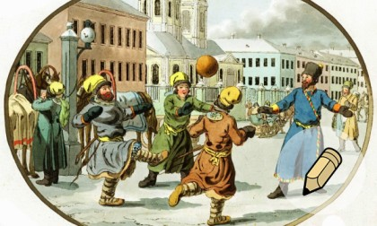
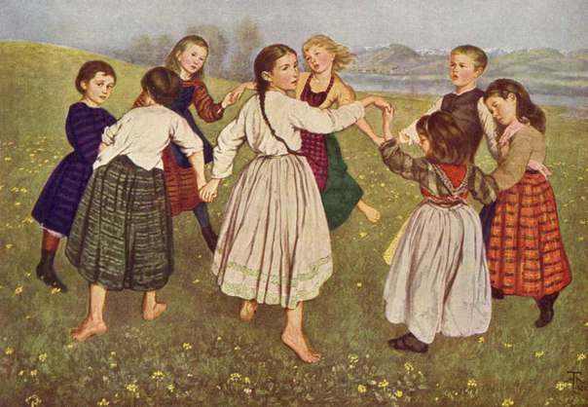
The games for adults
"Burners"
In the evening, the girls are going on a spacious place. Hand in hand, they are in pairs in a circle; one of them must "burn": it is placed in the middle of the circle and is, as it were indifferent. At this time the other girls run away in different directions in pairs, and one she will have time to separate, she takes her place
“Fist fight”
Most fisticuffs were "correct", is conducted according to the rules.
Here are the basics of the situation: to fight "for love" - that is, not have an enemy malice, not to beat the lying enemy, not to beat back, did not conceal his fist heavy objects, do not put the footrests and grab clothes of the enemy, not to kick (kick booted foot could cripple the opponent).

Slide 6
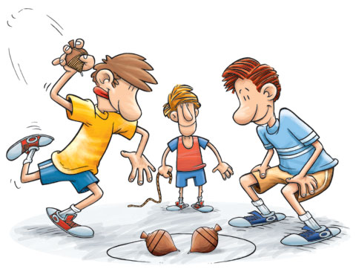
English traditional games
In England, the children don’t play very often outside in the street game, because their parents are afraid to let them out. And the children themselves do not want to play. British Children's Society confirms that the children began to play much less. The main reason for that is the fear: they are afraid of ridicule, bullying by other children and truly ubiquitous cars. Parents are worried that strangers may adhere to children. People do not like dirty playgrounds. Playing in the street is replaced by care services for children (childcare), where adults come to play with children. English national outdoor games for schools can be successfully used for the study of certain words in the English language.

Slide 7
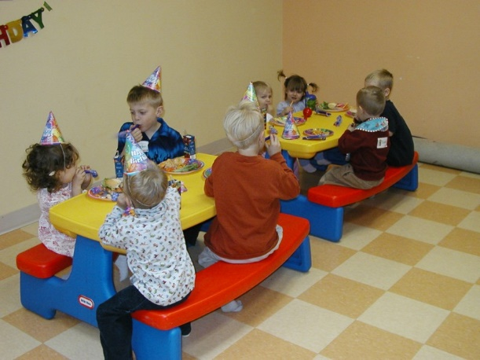
English games for children
"Receive Gift"
This fun is very popular, especially during the celebration of the birth. Gift in bright packaging is passed by the music.
Number of players: five and more, from 4 years of age and older.
What is needed: a surprise gift, colored paper, music.
How to play: fun toys, pack several layers of paper of different colors, seat the children in a circle, and turn on the music. Gift is passed around as long as the master does not turn off the sound. A child in the hands of which turned out to be a surprise, removes the first layer of paper. The game continues as long as the package is removed completely. The gift goes to the winner, and the circle allowed new souvenir. Adults should make sure that the gifts were presented to all players.

Slide 8
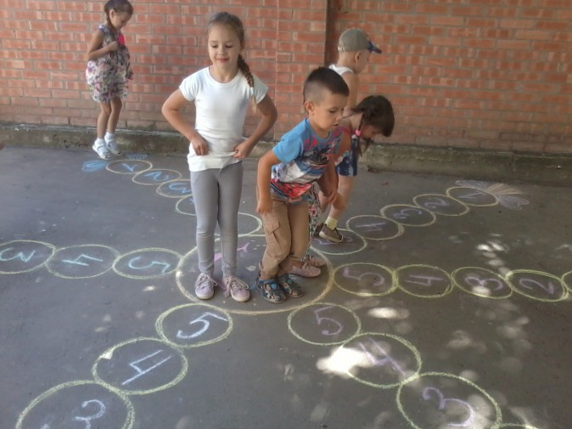
English games for adults
"Sea - ground" (Sea-Land)
Number of players at least 2.
Action: Draw a chalk circle. "The Sea" - is the center of the circle, the "land" - outside the circle.
Presenter gives the team:
- Sea! (All jump into the circle.)
- Ground! (All jump out of the circle.)
Traced a circle - is the sea. Around him - the earth. At the command of driving «Sea!» The players should quickly drop into the circle. According to the team: «! Ground» - jump ashore.
Whoever did it last – Eliminated.

Slide 9
Bibliography
Кенеман А. В. Детские подвижные игры народов СССР
Кудрявцев В. Ф. Народная подвижная игра как источник духовного и физического роста в дошкольном возрасте. // Дошкольное воспитание. 1998, № 11.
Литвинова И. Н. Детские народные подвижные игры. М., 1995
http://veselajashkola.ru/igry-onlajn/narodnye-podvizhnye-igry/
Уличные подвижные игры - http: // www.streetplay.come
Streetgames – уличные игры. Сайт для детей и их родителей - http: // www.streetgames.co.uk/
Street game- статья из Википедии с описанием игр и правил.
Party-games - групповые игры для взрослых и детей - http: //party-games.zaural.ru/party-games.htm
Games kids – игры для детей - http: //gameskidsplay.net/

