Slide 1
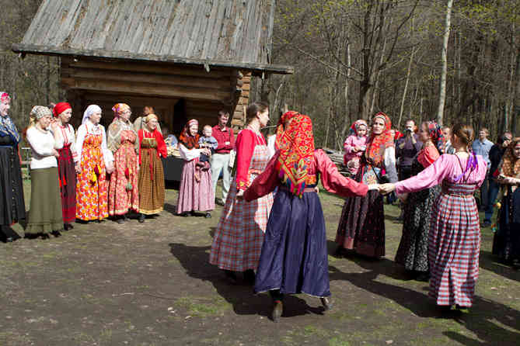
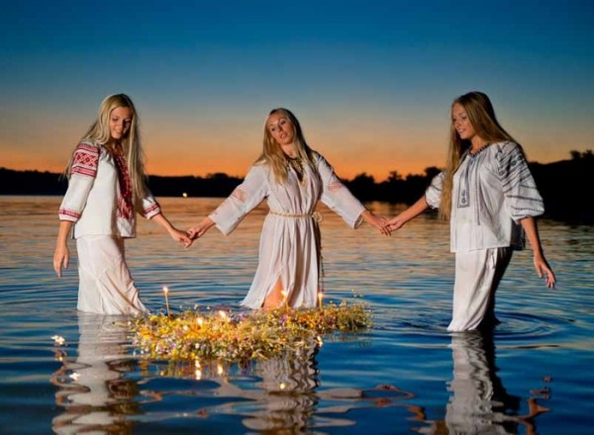
Ancient Russian and English holidays
Работу выполнила ученица
4б класса школы №33 г. Томска Исмагилова Юлия

Slide 2
The aim of project
To study
the Russian
and English holidays
The tasks of project
to find information at the library
to read the literature
to visit the museum

Slide 3
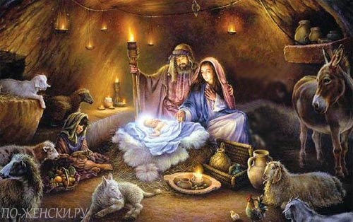
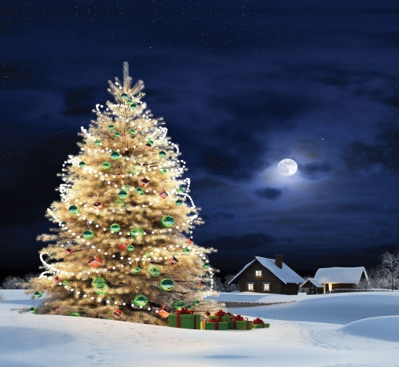
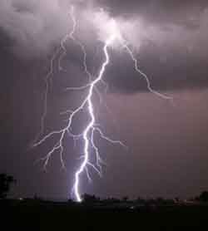
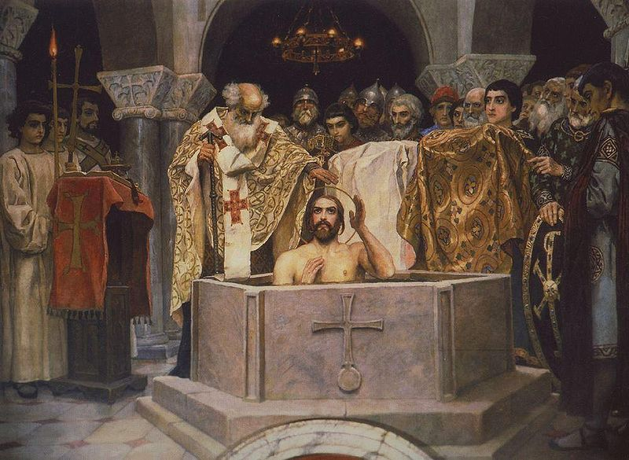
Winter holidays
Christmas
New Year
Epiphany
(Крещение)
Gromnitsa
(Громница)

Slide 4
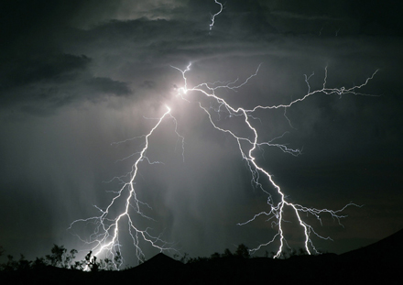
Gromnitsa
Gromnitsa is a single day in winter
when the storm can begin and people can hear the thunder and see lightning.
This day, the Slavs went to the house
with the icon and prayed (wading off evil spirits). The children were walking at sunset on the mountain and were asking sun to stay and if the sun stayed, the coldness will pass away, but if not the cold weather was for a long time.

Slide 5
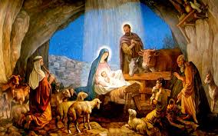
Christmas
Christmas is Christian holiday that celebrates the birth of Jesus Christ. For millions of Christians throughout the world it is the happiest and the busiest time of the year. No one knows the exact date of Christ's birth but most Christians celebrate Christmas on December 25. The word Christmas comes from Christes masse, an early English phrase that means Mass of Christ.
A Change In Ancient Traditions
This festival is all about culture and customs. However, not all traditions observed in the country are old. For example, roasted turkey, with Brussel sprouts and gravy, is the main attraction of the English Christmas feast in the twentieth century while it wasn't so in
the nineteenth century. In those days,
goose was considered the
traditional meat for Christmas.
This implies that the traditions aren't
really sacrosanct; they do change over time.

Slide 6
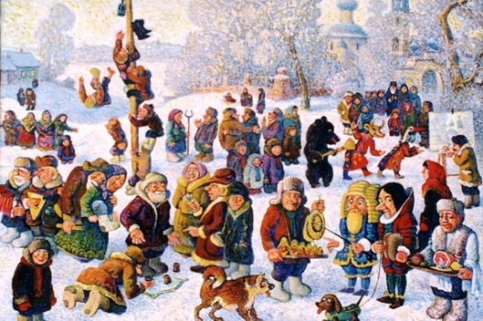
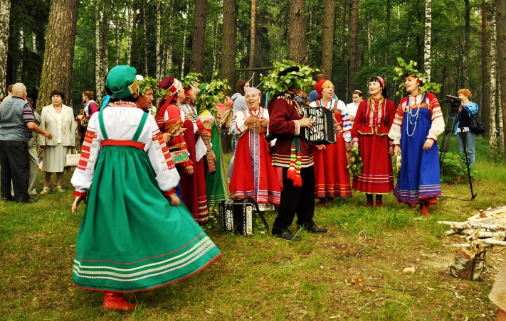
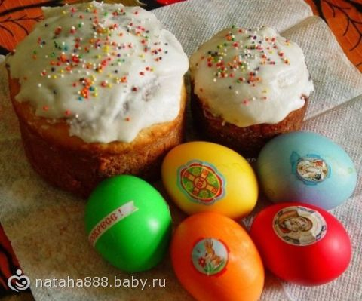
Spring holidays
Maslenitsa
(Масленица)
Red hill
(Красная горка)
Easter

Slide 7
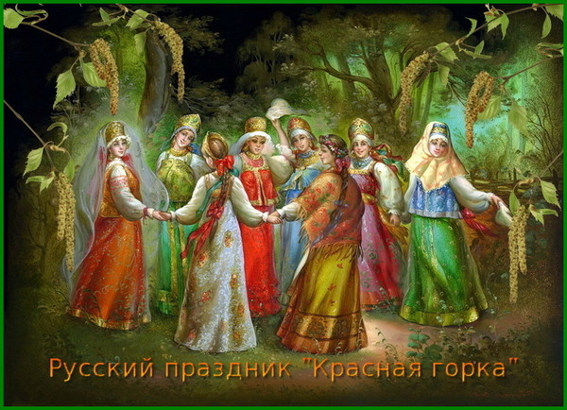
Red hill
Red hill is the first Sunday
after Easter and the last day
Easter week.
This day, it was very funny, people met
spring and organized festivals.
On Red hill usually young couples married or arranged games. Women weave
in spit ribbons and flowers, and the boys were playing games to attract young women.
Another tradition is to come to the bride and ask goodies (cakes, sweets and red eggs).
And why is it a Red Hill? Red it means beautiful.

Slide 8
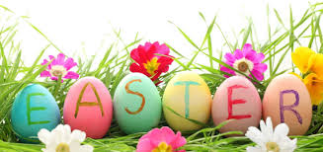
Easter
In the UK Easter is one of the major Christian festivals of the year. It is full of customs, folklore and traditional food. However, Easter in Britain has its beginnings long before the arrival of Christianity.
Many theologians believe Easter itself is named after the Anglo-Saxon goddess of the dawn and spring - Eostre.
In Britain Easter occurs at a different time each year. It is observed on the first Sunday after the first full moon following the first day of spring in the Northern Hemisphere. This means that the festival can occur on any Sunday between March 22 and April 25. Not only is Easter the end of the winter it is also the end of Lent, traditionally a time of fasting in the Christian calendar. It is therefore often a time of fun and celebration.
The Friday before Easter Sunday and the Monday after are a bank holiday in the UK.

Slide 9
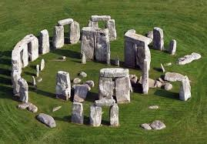
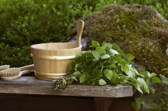

Summer holidays
Summer solstice
Agrafena Kupalnitsa
(Аграфена Купальница)
Sr.John the Baptist
(Ивана Купала)

Slide 10
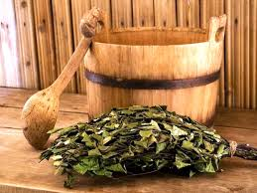
Agrafena Kupalnitsa
This holiday the Slavs associated with water and celebrated it on the eve of St. John the Baptist.
On this day men prepare the brooms and make them from different trees, and
some make brooms mixed, such as birch and rowan currant.

Slide 11
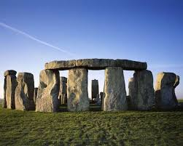
Summer solstice
For many bygone civilizations, the summer solstice—the longest day of the year—was endowed with great significance. People celebrated this special day, which falls in June in the northern hemisphere and is also known as midsummer, with festivals, celebrations and other observances, some of which still survive or have experienced a revival in modern times.

Slide 12
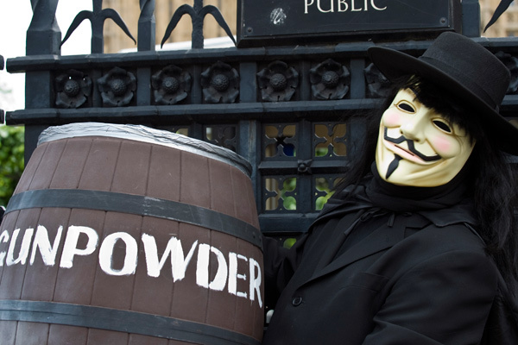
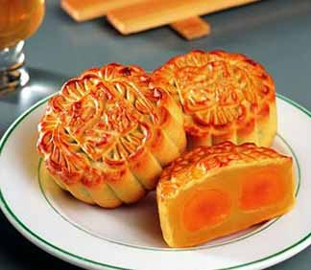
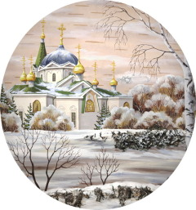
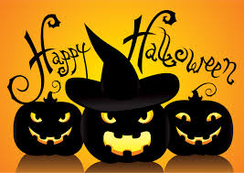
Autumn holidays
Guy Fawkes day
Rodogosh’
(Родогощь)
Virgiv’s mantel
(Покров)
Halloween

Slide 13
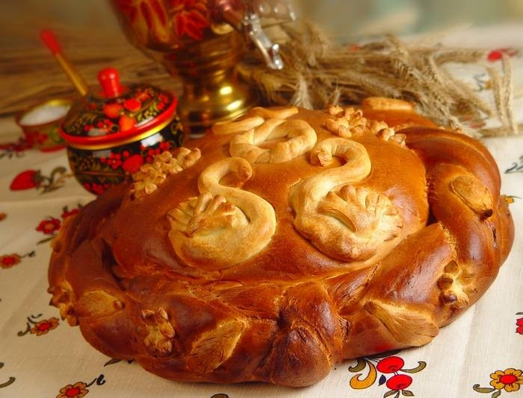
Rodogosch
Rodogosch is celebrated when the crop is harvested.
To this day huge honey cake is baked (in the old days it was baked as a man size) behind this cake the priest was hidden and asked, "Do you see me?"
if the answer was “yes”, then the priest wishes: "The next
year to collect even more harvest and bake
even more pie.”

Slide 14
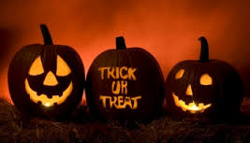
Halloween
Halloween is an ancient festival, which has its roots in the Celtic festival of Samhain (Sah-ween), this was when the Celts
(the ancient inhabitants of Great Britain) celebrated their New Year and the day they believed that the souls of those who had died that year progressed to the underworld. It was said to be a night when ghosts, demons and witches roamed the earth and people tried to placate them with offerings of nuts and berries.
Today in the UK it is celebrated on All Hallows Eve, the night of October 31, the last night of October which was originally the eve of Samhain.

Slide 15
Biobliografy
Интернет-ресурсы
www.alleng.ru
www.learnenglish.de
www.history.com
Литература
1. Е. Банников. Славянские праздники и обряды.
Издательство Гелеос, 2008 г, 416 с.
2. Н. Шапарова. Энциклопедия славянских праздников.
Календарные поверья и обычаи славян.
Издательство АСТ, Астрель, Lingua, 2010 г., 512 с.

